Slide 1

Document Title Extraction and Alternative Title Generation for Scientific Papers
College Name :-VishwaKARMA GOVERNMENT ENGINEERING COLLEGE
Team id sgh000045
Group NO : 4
Team Leader : Shanavas R S
Appu K
Joel Joseph
Jayakrishnan marar
Fathima Nasrin t n

Slide 2
PROBLEM STATEMENT
To develop a system to automatically extract title and author information from scientific documents and generate alternative titles based on the document content.
Brief Overview: Printed scientific documents hold valuable information, but manually extracting titles, authors, and key insights is time-consuming.
Challenges:
Inconsistent formatting across printed scientific publications.
Difficulty accurately digitizing text from images.
Isolating titles and author information from the rest of the document.

Slide 3
PROPOSED SOLUTION
TO THE PROBLEM
Overall Goal: To automatically process printed scientific documents and extract valuable information.
System Overview: A system combining:
Document Parsing: To extract text from images of printed documents.
Title and Author Extraction: Identifying these key components.
Content Analysis: Understanding the paper's focus.
Alternative Title Generation: Proposing titles that reflect the content.
Evaluation: Measure the system's performance on each task.

Slide 4
KEY OBJECTIVES
DOCUMENT PARSING WITH OCR
This stage transforms the scanned image of a scientific document into raw text that a computer can understand and process.
Challenges: Printed documents can have variations in font styles, sizes, and layouts.
Tools and Techniques: Optical Character Recognition (OCR):
Libraries like pytesseract is used for OCR in Python and PIL is used for image handling.
Preprocessing: Preprocesses the text extracted from OCR, cleaning and refining it for further analysis. It removes non-alphanumeric characters, handles potential page numbers, headers, and footers, and reduces whitespace.

Slide 5
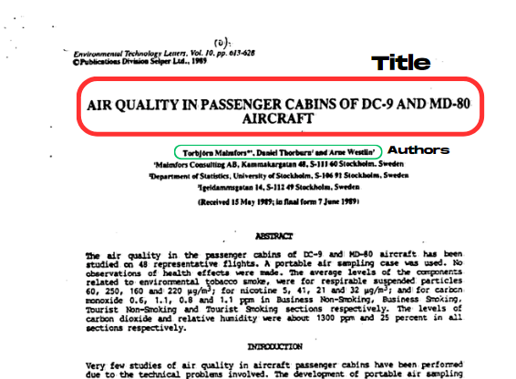
TITLE AND AUTHOR EXTRACTION
Header Parsing: Analyze the document's initial sections for larger font sizes, bolding, or centered text, which often indicate the title.
Citation Pattern Recognition: Utilize regular expressions or pre-trained models to recognize common author name formats within citations (e.g., "Smith, J. (2023)").
Named Entity Recognition (NER): Employ NER models trained specifically on scientific publications to reliably identify author names within the text.

Slide 6
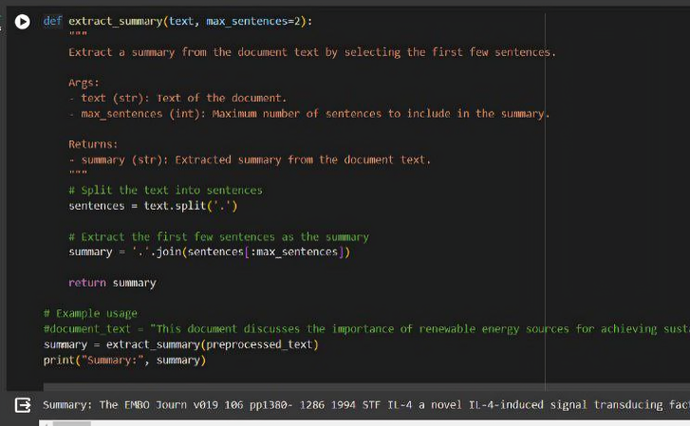
CONTENT ANALYSIS
Summarization helps us efficiently grasp the document's core message and facilitates further analysis.
Selects the most important sentences from the original text to form a summary.
Ranking sentences based on factors like word frequency, position in the document, and presence of keywords.
Using statistical methods to identify sentences most likely to represent the overall content.

Slide 7
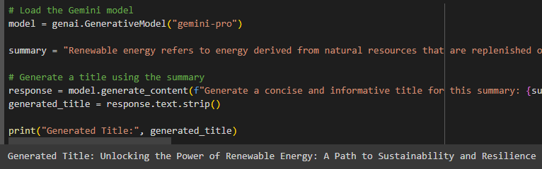
ALTERNATIVE TITLE GENERATION
Goal: Craft title options that accurately and creatively reflect the content of a scientific document.
Powerful AI Models: Utilize advanced language models like the "gemini-pro" model for text generation.
Content Analysis: Thoroughly analyze the document (using keyword extraction, summarization, etc.) to create an effective representation of the core ideas
Feeding the Model: Provide the summary or key concepts from the document as a prompt for the AI model.
Title Generation: The trained AI model generates a selection of alternative titles.

Slide 8
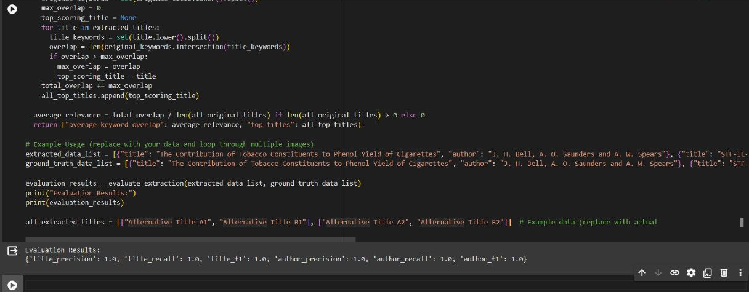
EVALUVATION
Result

Slide 9
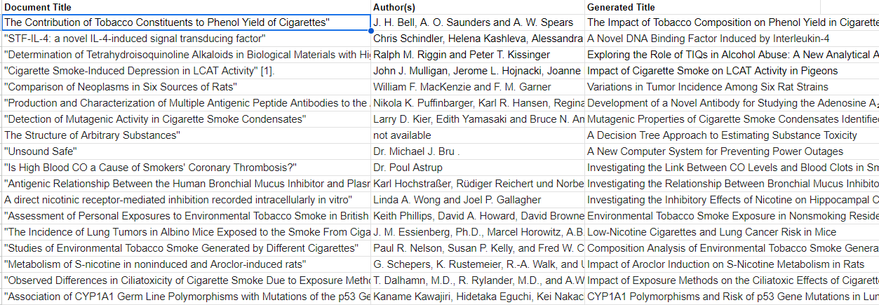
Output

Slide 10
CONCLUSION
The Challenge: Extracting insights from printed scientific documents can be time-consuming due to the need for manual processing.
Our Solution: An automated system combining document parsing, title/author extraction, content analysis, and AI-powered title generation.
Benefits:
Faster access to research findings.
Improved search and discovery of scientific papers.
The Future: Continued development of such systems holds the potential to transform how we interact with and utilize scientific knowledge.

